Slide 1

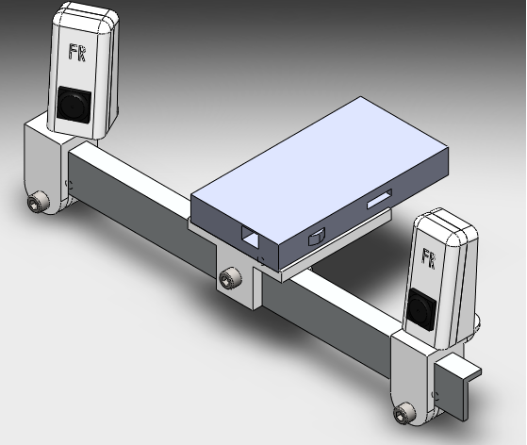
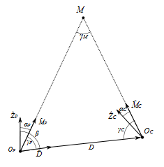
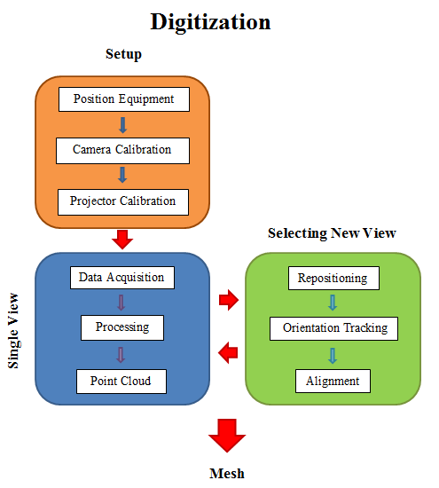

Fully Reversed Engineering
CHSLT – ME
Center for Holographic Studies and Laser μmechaTronics
Objectives
4. HARDWARE
6. RESULTS
To design a system for rapid digitization of physical objects for the purpose of reverse engineering
To create a low cost alternative for expensive digitization solutions
To create a streamlined process for digitization that requires minimal user interaction
1. Motivation
2 . Reflected Binary –Sinusoidal Hybrid: A structured Light Technique.
5. SCANNING PROCESS
3. SIMULATED TESTING
(a)
7. CONCLUSIONS AND FUTURE WORK
8. ACKNOWLEDGEMENTS
9. REFERENCES
Notes:
Put the two otoscopes together – may be put a diagram of what’s inside

